Slide 1
Statistical Principles in Bioinformatics
Xutao Wang
Oct. 23 2025

Slide 2
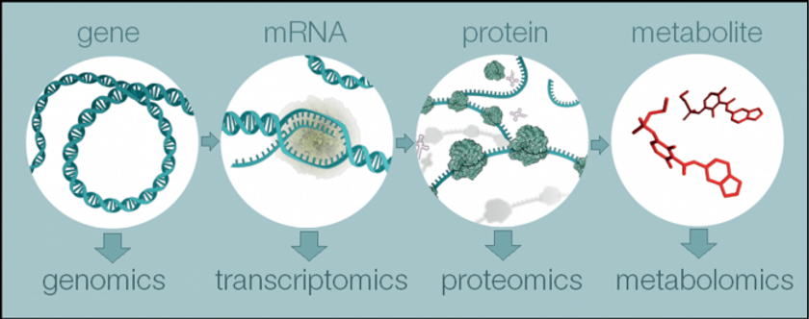
Bioinformatics
Integration of biology, statistics, and computer science
Analyze large-scale biological data (genomics, transcriptomics, proteomics, etc.)
Goal: extract meaningful biological insights from noisy data
Notes:
as it sits at a very informative layer of biology to study gene expression.

Slide 3
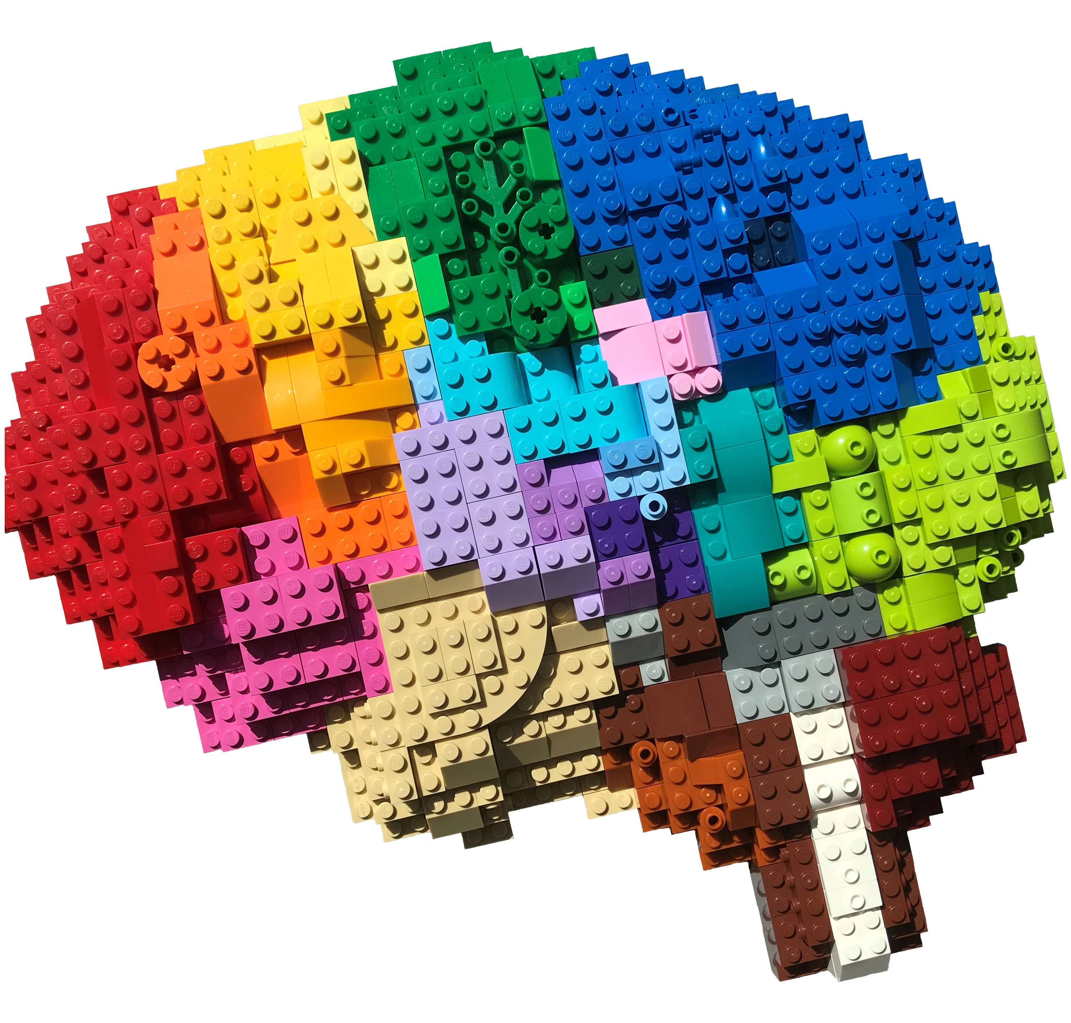
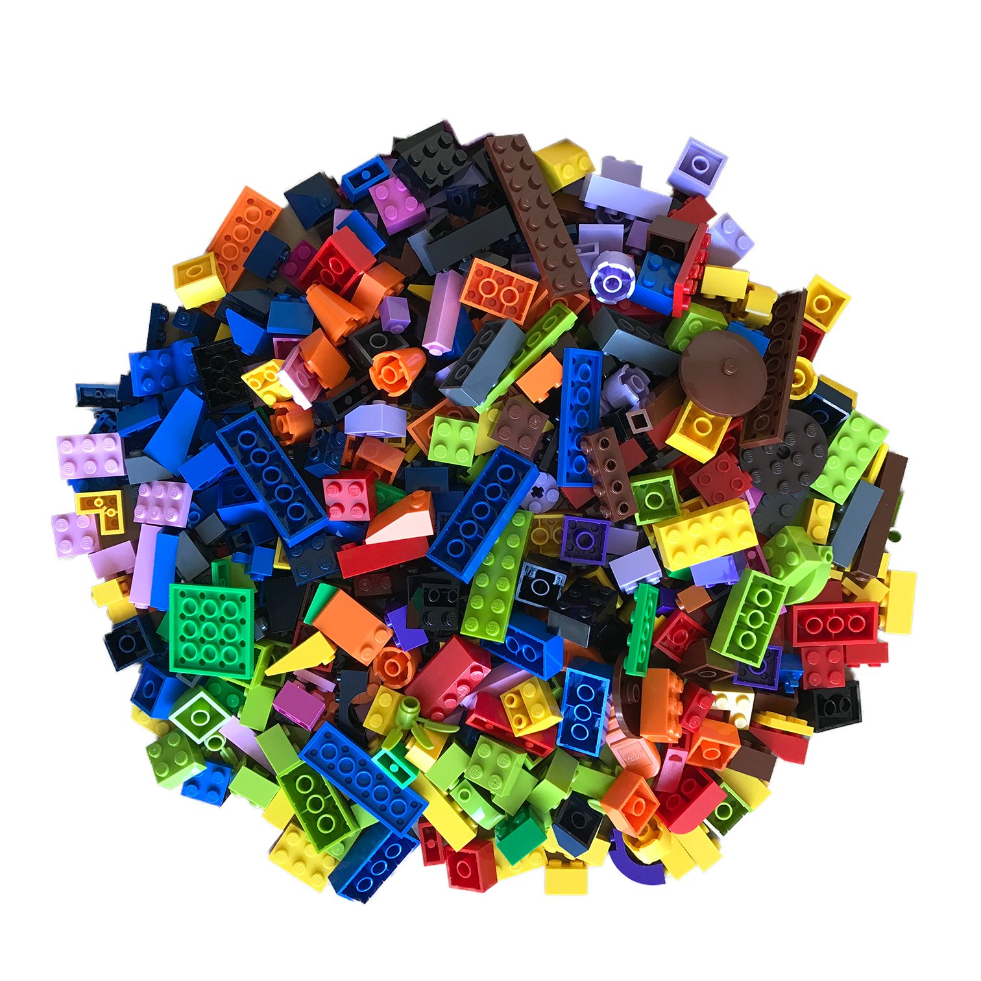
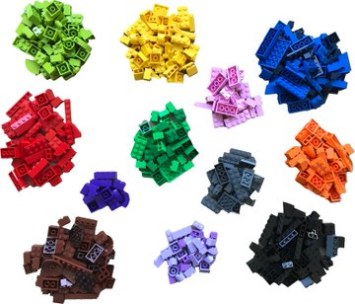

Why Statistics Matter
Reliable Inference
Reproducibility
Uncertainty quantification
DEseq2
Limma
Seurat
Monocle3
Scanpy
Seurat
Scanpy
Bulk RNA-seq
Single Cell RNA-seq
Spatial Transcriptomics
Image credit to Bo Xia: https://x.com/BoXia7/status/1261464021322137600
Notes:
Biological data are complex and variable
Experiments involve limited samples but millions of features
Different technologies require distinct statistical methods — all aiming to ensure reliable inference, reproducibility, and quantified uncertainty.

Slide 4
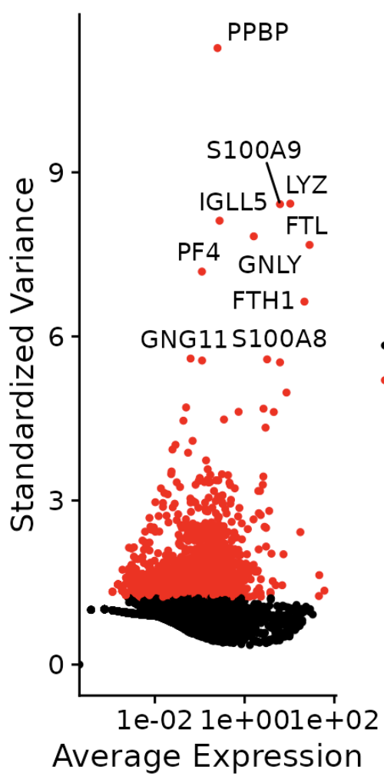
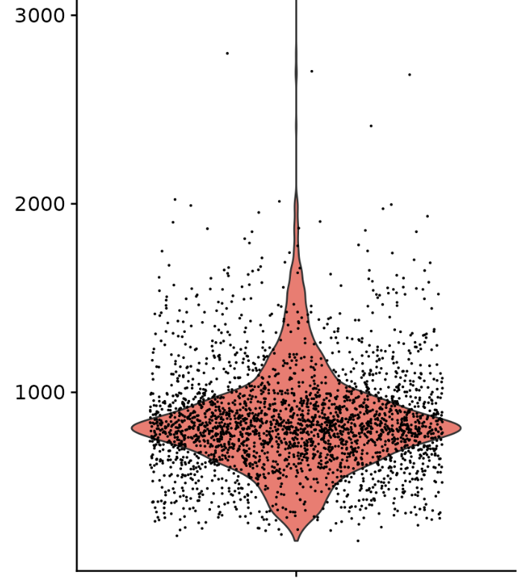
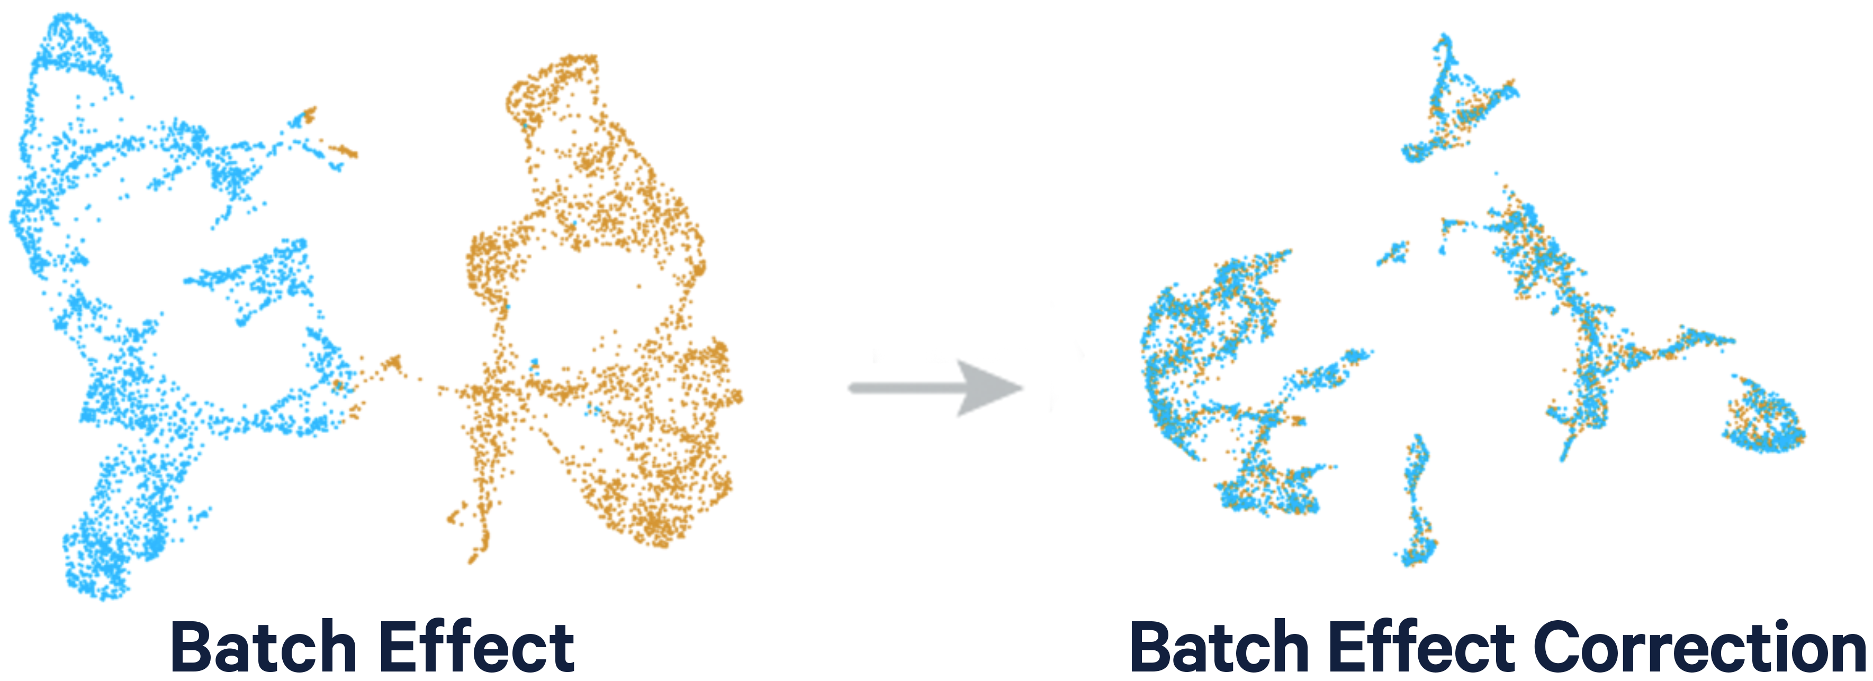
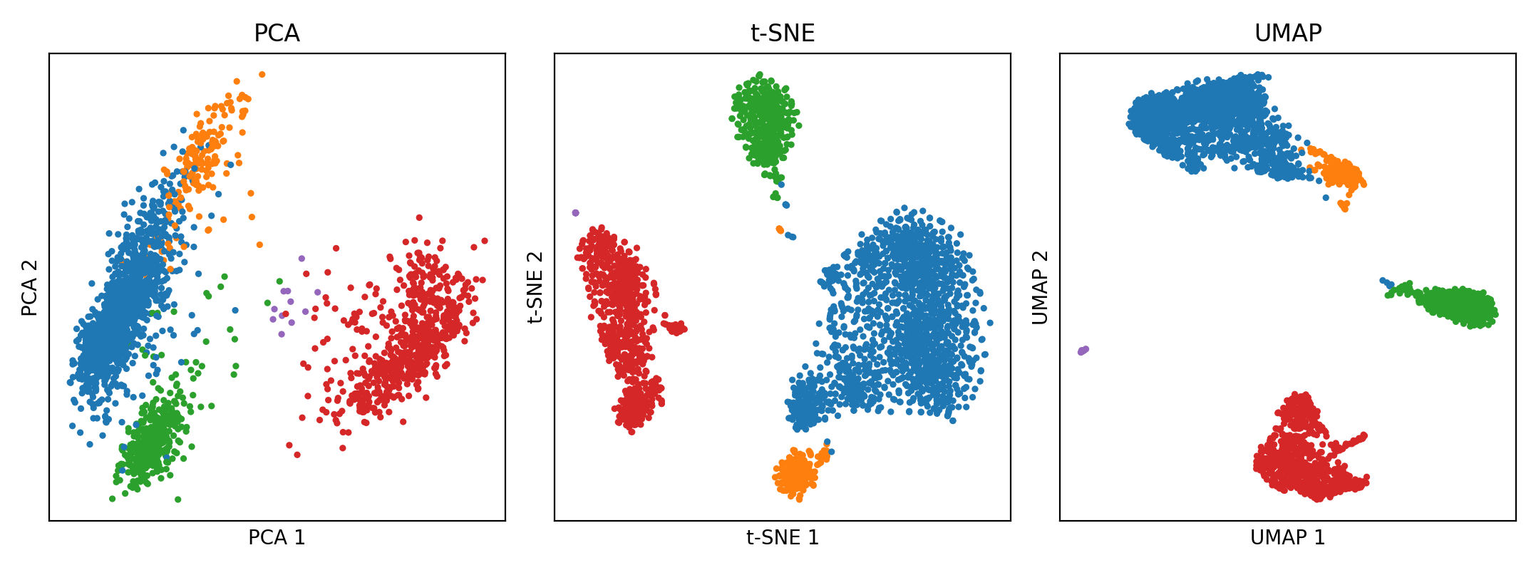
Data Quality & Normalization & Batch Correction
Preprocessing:
Filtering low-quality genes/cells
Normalized data to identify HVG (cpm, tpm)
Batch correction (combat-seq, harmony)
Dimensionality Reduction:
PCA, tSNE, UMAP
Notes:
dimensionality reduction for data visualization
the classical principal components analysis (PCA) uses a linear mapping to project data down to a space that preserves as much variance as possible. More recently, the t-SNE and UMAP algorithms use nonlinear mappings that attempts to that attempts to preserve neighborhoods of nearby data points while preventing overlapping dense regions of data in the output figure.

Slide 5
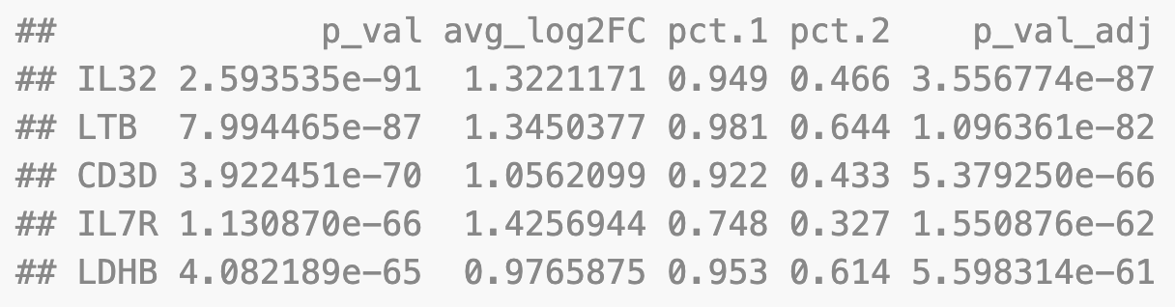
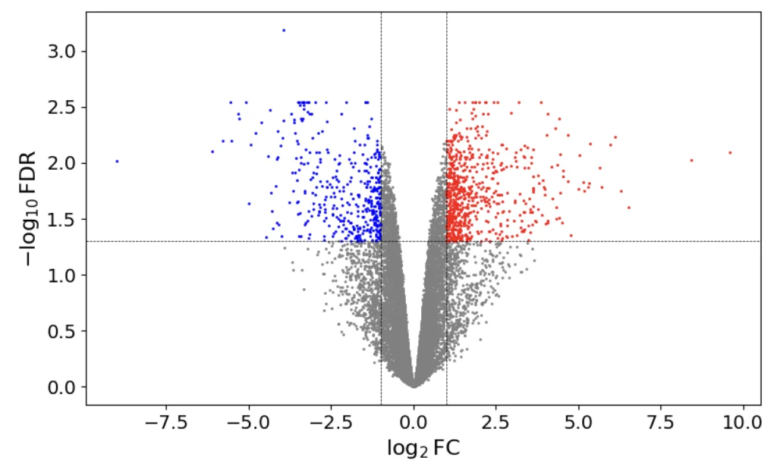
Statistical Inference
Estimate effects and test hypotheses
Wald test (Deseq2), Wilcoxon test (Seurat)
Multiple Testing
~20,000 genes per sample → many false positives if unchecked
Control false discoveries (adjusted p-value):
FDR / Benjamin-Hochberg Procedure (Deseq2)
Bonferroni-correction(Seurat)
Notes:
Finding differential expressed genes across two clusters or your phenotype of interest
both statistically significant (high on the y-axis) and have a large effect size (far left or right on the x-axis).

Slide 6
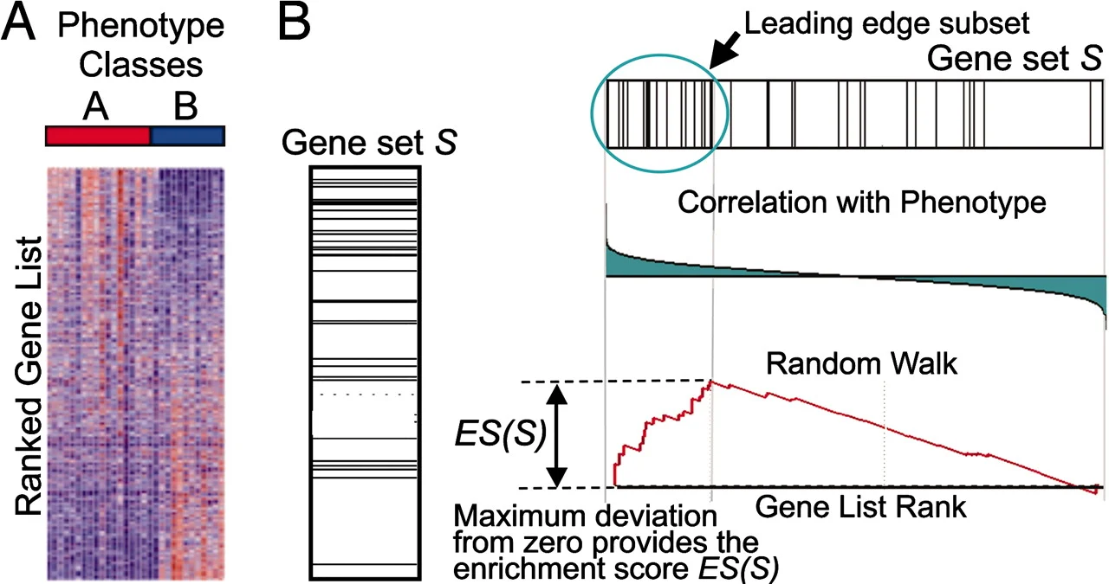
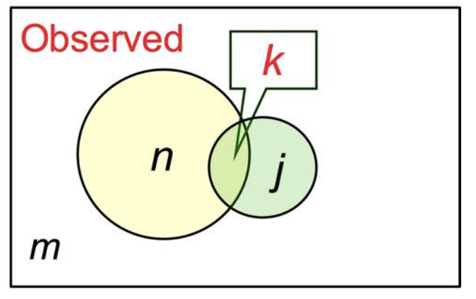
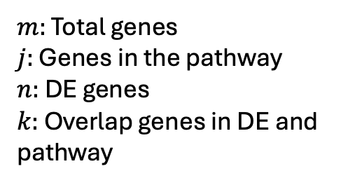
Functional Enrichment & Pathway Analysis
Individual gene-level signals → pathway-level insights (clusterProfiler)
Explore functional pathways from database (i.e. KEGG, REACTOME, GO)
Test whether predefined gene sets are enriched (i.e. TBSignatureProfiler)
Gene set enrichment analysis (GSEA): Kolmogorov–Smirnov like running-sum statistic
Over representation analysis (ORA): Hypergeometric Test
GSEA
ORA
$m:$ Total genes
$j:$ Genes in the pathway
$n:$ DE genes
$k:$ Overlap genes in DE and pathway

Slide 7
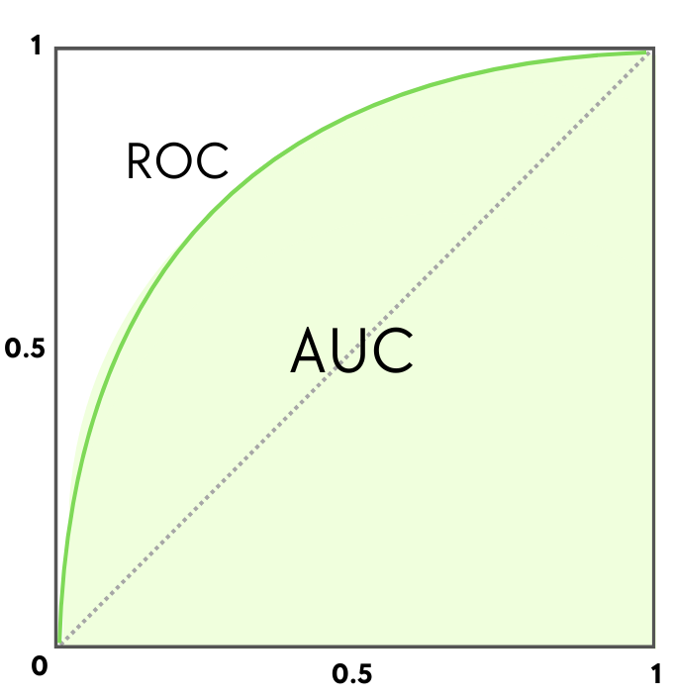
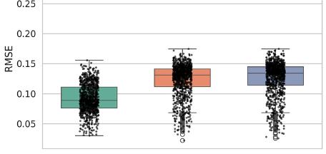
Modeling and Prediction
Receiver Operating Characteristics (ROC) curve
Models turn data into biological predictions:
Forecast outcomes on unseen data
Youden's J statistic:
max(sen + spec – 1)
Classification
Sensitivity (TPR)
Predict categories (disease vs. healthy, responder vs. non-responder)
Methods: logistic regression, random forest, support vector machine etc.
Metrics: Accuracy, Sensitivity, Specificity, AUC etc.
[1 – Specificity] (FPR)
Regression
Predict continuous or count variable (expression level, survival time)
Methods: linear regression, cox-regression, generalized additive model etc.
Metrics: RMSE, Deviance, c-index
Notes:
In bioinformatics, most predictive questions fall into classification Deviance: analogous to the Residual Sum of Squares (RSS) in linear regression.
• Concordance Index (C-index)
Measures how well the model ranks survival times. $C=P\left(\text{predicted} \text{risk} \text{higher} \text{for} \text{those} \text{who} \text{die} \text{earlier}\right)$
Ranges from 0.5 (no discrimination) → 1.0 (perfect ranking).
Analogous to ROC-AUC for survival data.

Slide 8
Integration across Datasets & Modalities
Cross-study integration (same modalities)
Meta-analysis: Combine effect across studies (random effect model)
Batch correction: integrate transcriptomics data (combat-seq, BBKNN, Harmony)
Ensemble learning: combine models trained on individual datasets (stacking, adaptive weighting, domain adaptation)
Multi-omics integration (different modalities)
Graph-based methods: Map data to shared latent space across modalities (WNN)
Joint embedding: Learn latent space using deep learning methods (scGPT, geneformer)
AI agent: use LLM to automate modality selection, data preprocessing, and model orchestration (Biomini, ToolUniverse)

Slide 9
Key Takeaways & References
Statistics underpins all stages of bioinformatics
Integration across studies improves robustness
Clinical data + multi-omics = systems-level precision medicine
AI agent enables automated analysis
References
Benjamini & Hochberg (1995) FDR control, JRSS B
Love et al. (2014) DESeq2, Genome Biology
Hao et al. (2021) Seurat / WNN, Cell
Cui et al. (2024) scGPT, Nature Methods
Gao et al. (2024) Biomedical discovery with AI agent, Cell

